Slide 1
Food ＆ Drink 1
WATER
JUICE
APPLE
PEACH
POTATO
STRAWBERRY
ICE CREAM
CUCUMBER
NEXT

Slide 2
Food ＆ Drink 2
Tea
Milk
Bread
Sandwich
NEXT

Slide 3
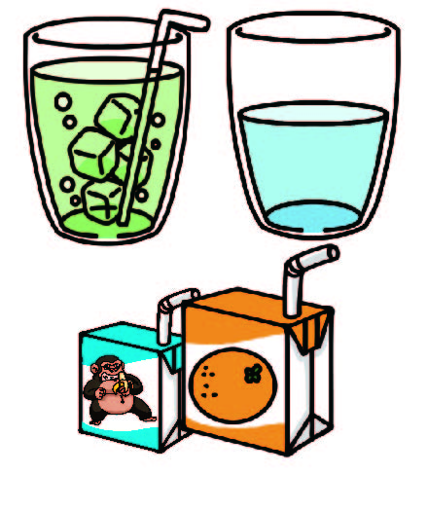
Food types
Meat
Fruit
Vegetable
Drink
Dessert

